Slide 1
A Programmer: uses the toolset
Python Programming

Slide 2
Variables
Integers (immutable!!!)
Floats
Booleans (True/False)
Strings (immutable!!!)

Slide 3
In/Out
print(message)
resultStr = input(prompt)
resultVal = int(input(prompt))

Slide 4
Collections
Tuple (1,2,3) (immutable)
List [1,2,3]
Set {1,2,3} (unique/ordered)
Dict {"a":1, "b":2, "c":3}
also unique and ordered on keys

Slide 5
Casting
tuple(myList)
list(myTuple)
set(myList)
dict (myTuple)

Slide 6
Strip, Split & Join
reply = " Hello ,World "
trimmed = reply.strip()
# .lstrip(), .rstrip(), strip(',')
listOfWords = trimmed.split(',')
listOfChars = list(trimmed)
"".join(myList)
"fred".join(myList)

Slide 7
Program Flow
if
while
for
match (need python 3.10 or later)

Slide 8
Syntax
colon :
indent
same indent
result = functionCall(argA, argB)
=,==
+=
and / or / not

Slide 9
Operators
or logical OR
and logical AND
not logical NOT
< <= > >= comparison operators
== != equality operators
is object identity test
in object membership test
| ^ & binary OR, XOR, AND
<< >> binary shift
- + subtract, add
* / // % multiply, divide, integer-divide, modulo
~ ** complement, exponentiation

Slide 10
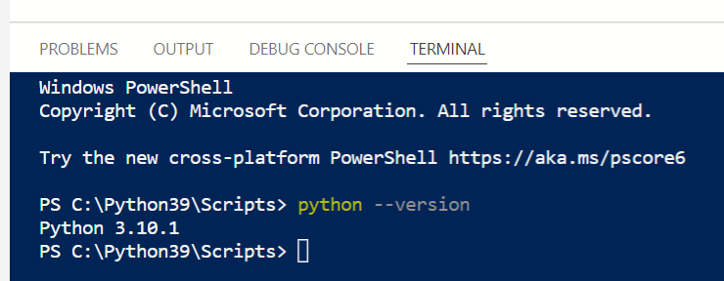
Install Python 3.10
1
2
If version is not 3.10 or higher:
Browser: python.org/downloads

Slide 11
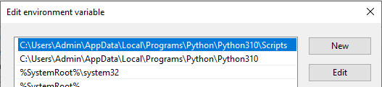
Windows env variables
Start->"env"
Edit system path
add path to python 3.10

Slide 12
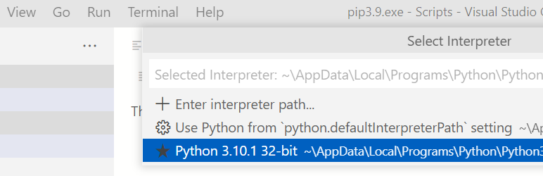
VSC Select Interpreter
View-> Command Pallete
->python:Selected Interpreter

Slide 13
enum
from enum import Enum, auto
class state(Enum):
OFF = auto()
LOAD_STATE = auto()
CHECK_HOPPERS = auto()
READY = auto()
GET_SELECTION = auto()
….

Slide 14
match
def state_machine(currentState):
match currentState:
case state.OFF:
case state. CHECK_HOPPERS:
….

Slide 15
State Machine
In Coffee_machine folder
state_machine.py
Enum for machine-states
def state_machine(state):
Use match to call functions for each state
The functions should return the new state

Slide 16
import
In state_machine.py
To call functions in other folders
from subFolder.myFile import *
from .siblingFile import *

